Slide 1
Car Accident Severity Prediction
Vedant Mane
IBM Capstone Project

Slide 2
The Problem:
Car Accidents → Major issue around the globe
Personal vehicles: Increasing day by day
Seattle, Washington: 2x cars since 2010
Increase in Car Accidents around the city

Slide 3
Data Source & Pre-processing:
Data Source: Given by IBM for the project.
Metadata: Link
Dataset: 37 Features, 194673 Obervations.
Pre-Processing:
SEVERITYCODE: 0 → Property Damage, 1 → Injury
Integer Encoding: INATTENTIONIND, UNDERINFL, SPEEDING , JUNCTIONTYPE
One-hot Encoding: LIGHTCOND, ROADCOND, WEATHER
Normalize

Slide 4
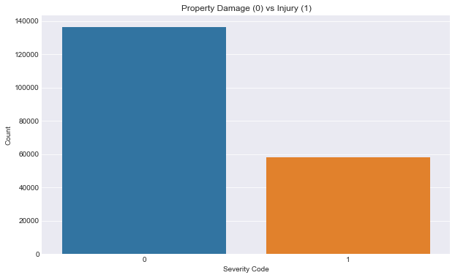
Getting Insights on Data:
Highly Skewed Target Variable

Slide 5
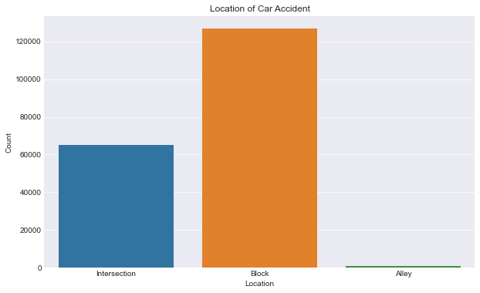
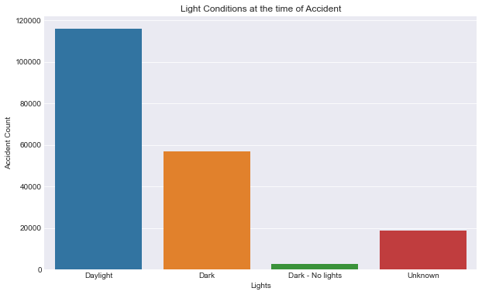
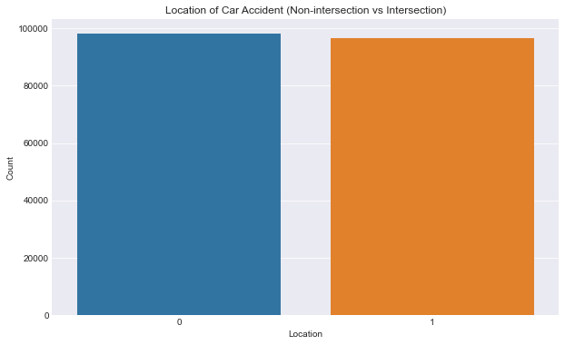
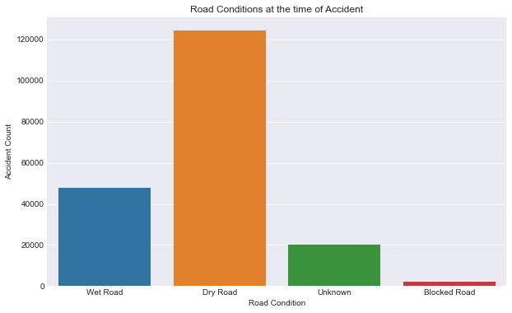
“ADDRTYPE”
LIGHTCOND
“JUNCTIONTYPE”
ROADCOND

Slide 6
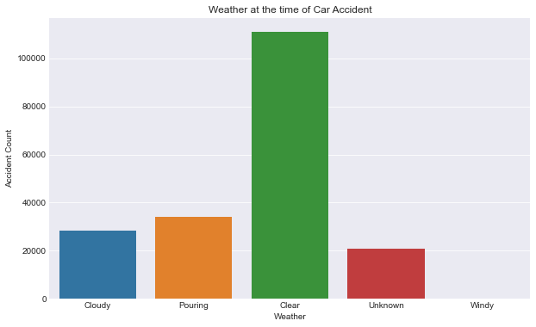
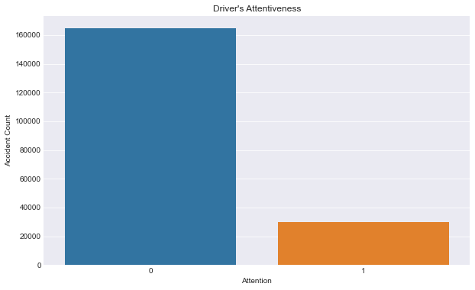
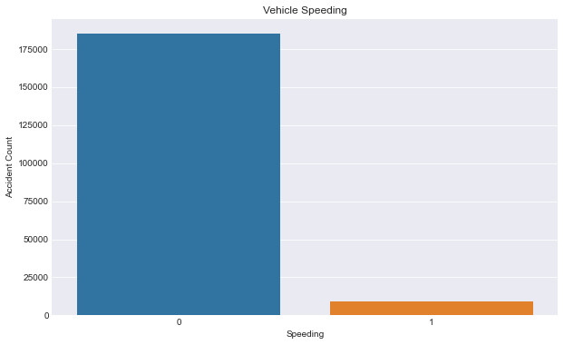
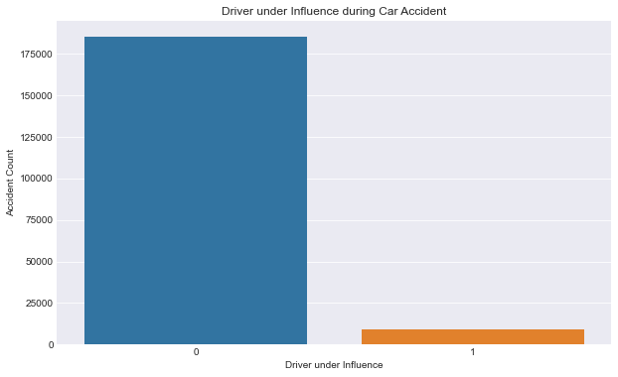
“WEATHER”
“INATTENTIONIND”
“SPEEDING”
“UNDERINFL”

Slide 7
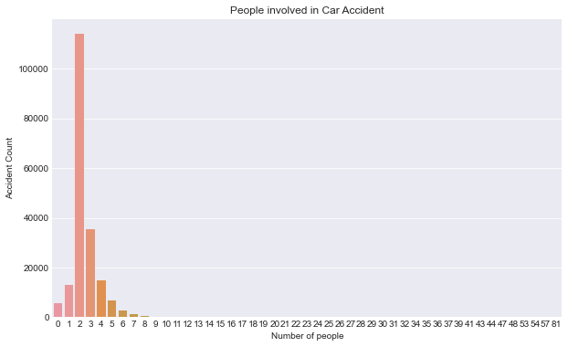
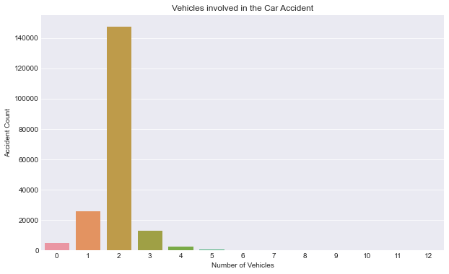
“VEHCOUNT”
“PERSONCOUNT”

Slide 8
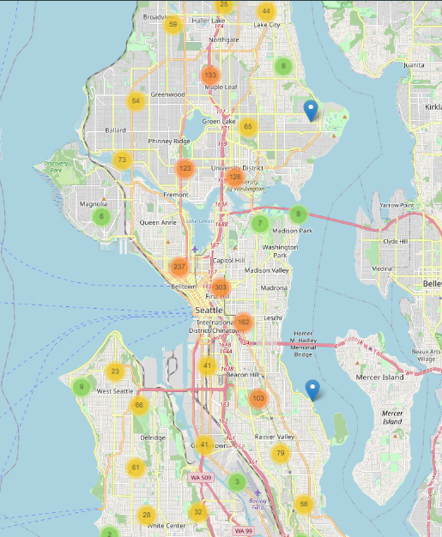
Map of Seattle, Washington explaining car accidents in different locations

Slide 9
Model Building
Classification Problem
Use:
Logistic Regression
Decision Tree
KNN – Performs poorly for highly skewed datasets.
SVM – Not suitable for large datasets.

Slide 10
Logistic Regression:
Logistic Regression Classifier
Scikit-Learn Library
Parameters: C = 0.01 (Regularization Strength), Solver = “liblinear”
Classification Report:
 | Precision | Recall | F1 Score | Support
0 | 0.82 | 0.63 | 0.71 | 27345
1 | 0.43 | 0.67 | 0.52 | 11590
Accuracy |  |  | 0.64 | 38935
Macro average | 0.62 | 0.65 | 0.62 | 38935
Weighted average | 0.70 | 0.64 | 0.65 | 38935
Log loss |  |  | 0.63

Slide 11
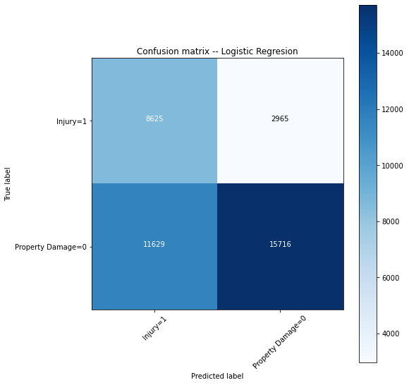
Confusion Matrix

Slide 12
Model Evaluation:
Accuracy Score: 0.63850006420958
F1 – Score: 0.5240912933220624
Log Loss: 0.6311264004171047

Slide 13
Decision Tree:
Decision Tree Classifier
Scikit-Learn Library
Parameters: Criterion = “entropy”, max_depth = 4
Classification Report:
 | Precision | Recall | F1 Score | Support
0 | 0.84 | 0.57 | 0.68 | 27345
1 | 0.43 | 0.74 | 0.54 | 11590
Accuracy |  |  | 0.63 | 38935
Macro average | 0.63 | 0.66 | 0.61 | 38935
Weighted average | 0.72 | 0.63 | 0.64 | 38935

Slide 14

Confusion Matrix

Slide 15
Model Evaluation:
Accuracy Score: 0.6251701553871838
F1 – Score: 0.5417033036050747

Slide 16
Discussion:
Algorithm | Average F1 Score | Property Damage (0) vs Injury (1) | Precision | Recall
Logistic Regression | 0.65 | 0 | 0.82 | 0.63
 |  | 1 | 0.43 | 0.67
Decision Tree | 0.64 | 0 | 0.84 | 0.57
 |  | 1 | 0.43 | 0.74
Both models → Similar Accuracy
Logistic Regression: Balanced Recall
Decision Tree: Better Precision

Slide 17
Recommendations:
Launch development projects for those areas with higher concentration of accidents and most severe accidents in order to minimize the effects of these two factors.
Install safety signs on roads and ensure all necessary precautionary measures are taken by the people living in the area.
Be extra careful around the highways along the city’s centre as it has the highest number of accidents reported.

Slide 18
Conclusion:
Comparing both models
Similar accuracy scores for target variables
Decision Tree → Higher Precision
Logistic Regression → Balanced Recall
Suggestion: Use both models based on requirements.
The models could have performed better if a few more things were available:
A balanced dataset for the target variable
More instances of the accidents recorded that took place in Seattle, Washington.
Less missing values for features such as Speeding and Under Influence.
More factors, such as precautionary measures taken while driving, etc.

Slide 19
Thank you!!!

